Slide 1
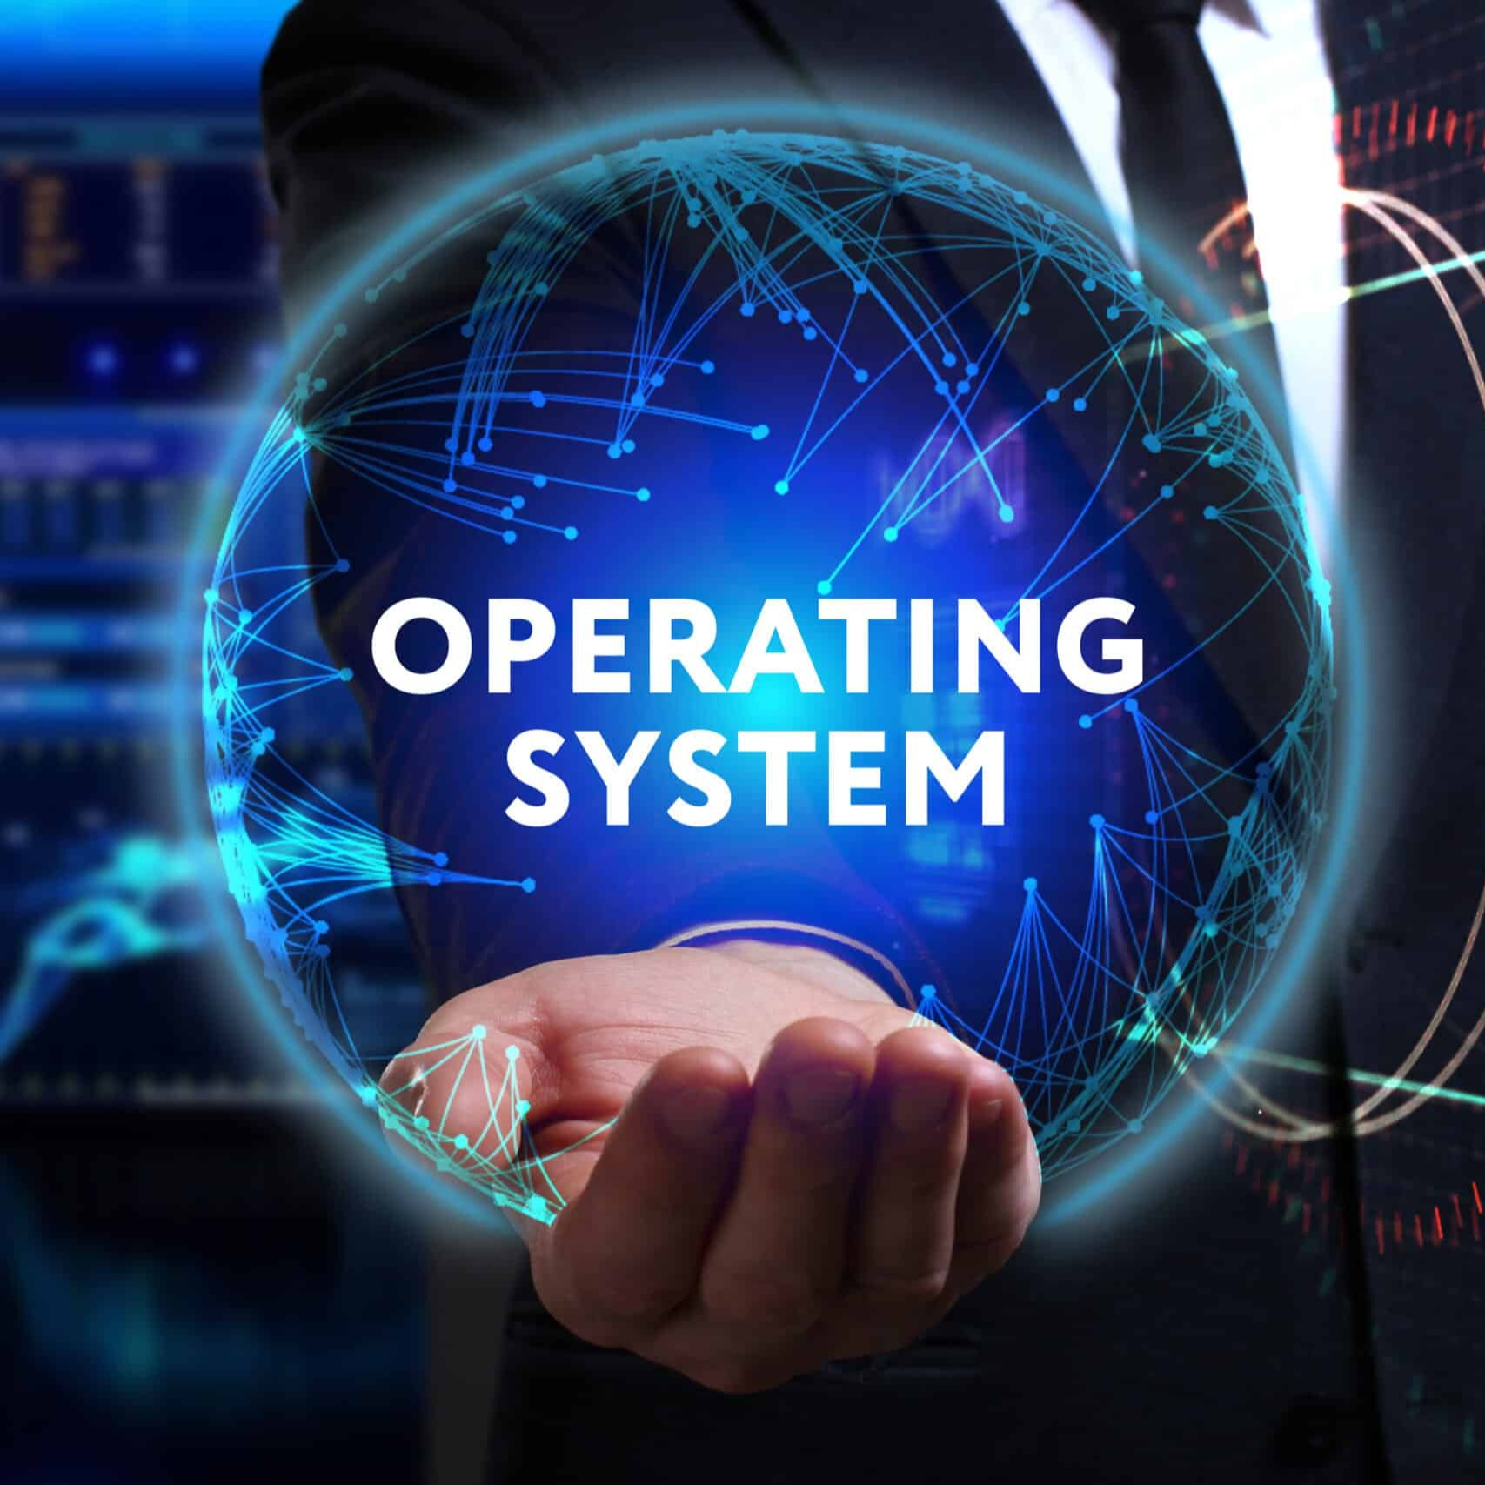
What is operating system?
-The software which controls and coordinates overall functions of a computer is called operating system.
-An operating system is a program that acts as an interface between the software and the computer hardware.

Slide 2
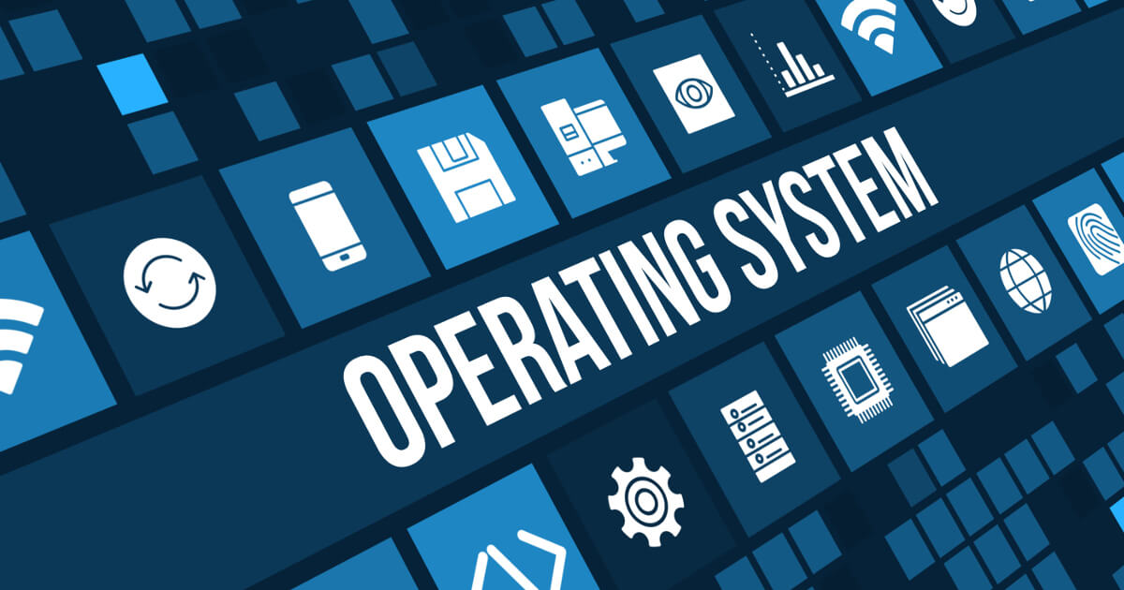
Popular Operating System
Windows 7
Windows 8
Windows 10
Unix
Linux
VMS
OS/400
AIX

Slide 3
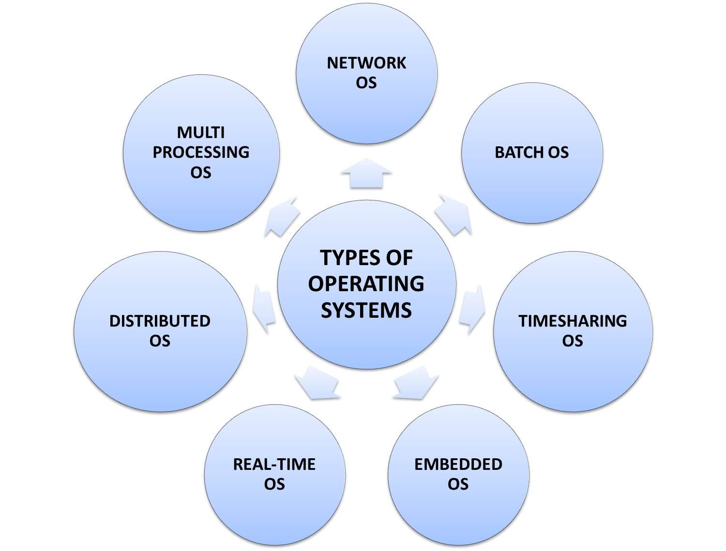
Types of Operating System

Slide 4
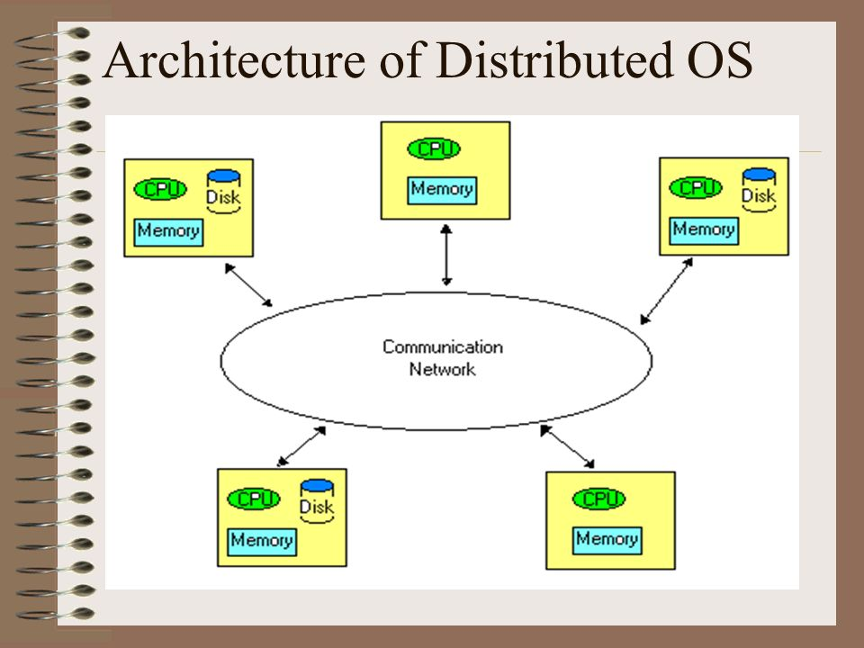
Distributed Operating System
It is a system which uses multiple central processors to serve multiple real time application and multiple users.
Data processing jobs are distributed among the processors accordingly.

Slide 5
Advantages of distributed system are as follows:
Resource Sharing: Enables sharing of hardware and software resources across multiple system.
Fault tolerance: If one mode fails, others can take over the workload, ensuring system reliability.
Improved Performance: Tasks can be distributed across multiple systems, reducing processing time.
Cost Efficiency: Reduces the need for high performance individual systems by pooling resources.
Transparency: Provides a unified system view, hiding the complexity of multiple systems from users.

